Slide 1
KEERTHY RAAJ SHANMUGAM - 200467266

Slide 2
Web Map
https://georgiancollege.maps.arcgis.com/home/webmap/viewer.html?webmap=4a7c4b2475fc48b2bf0aa38fb4755a5f

Slide 3
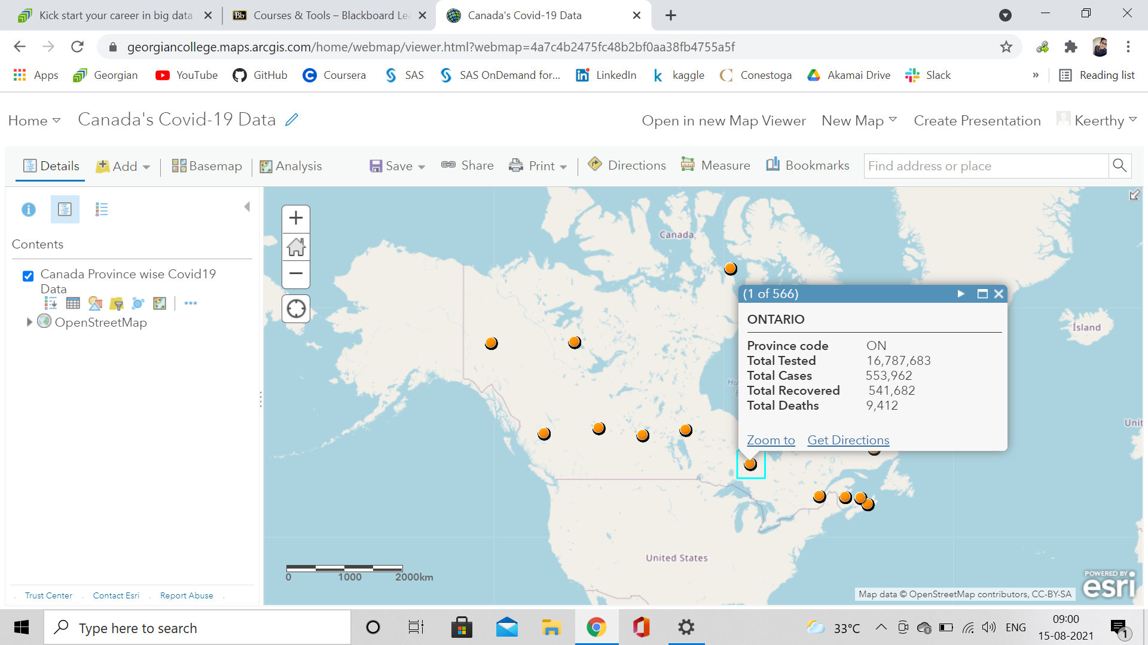

Slide 4
Dashboard
https://georgiancollege.maps.arcgis.com/apps/dashboards/c4846136cda9462ba478970d78ce3bb2

Slide 5
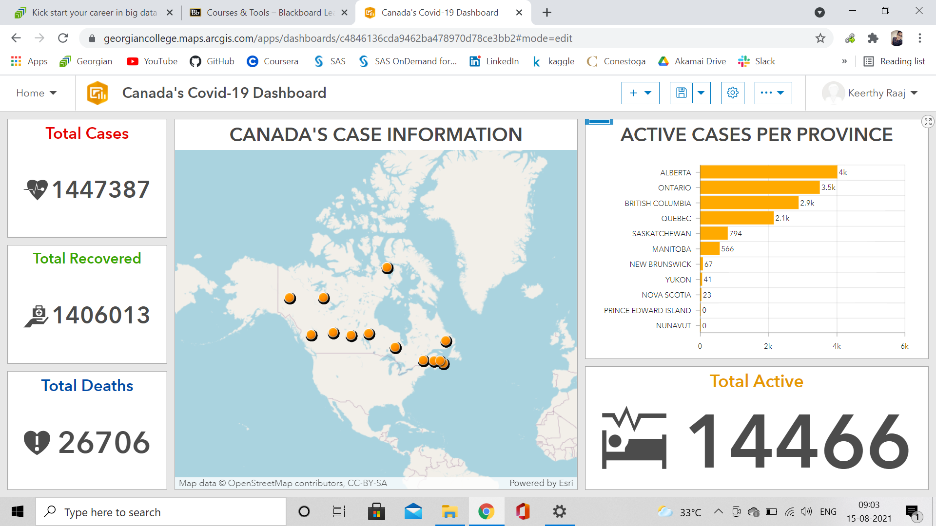

Slide 6
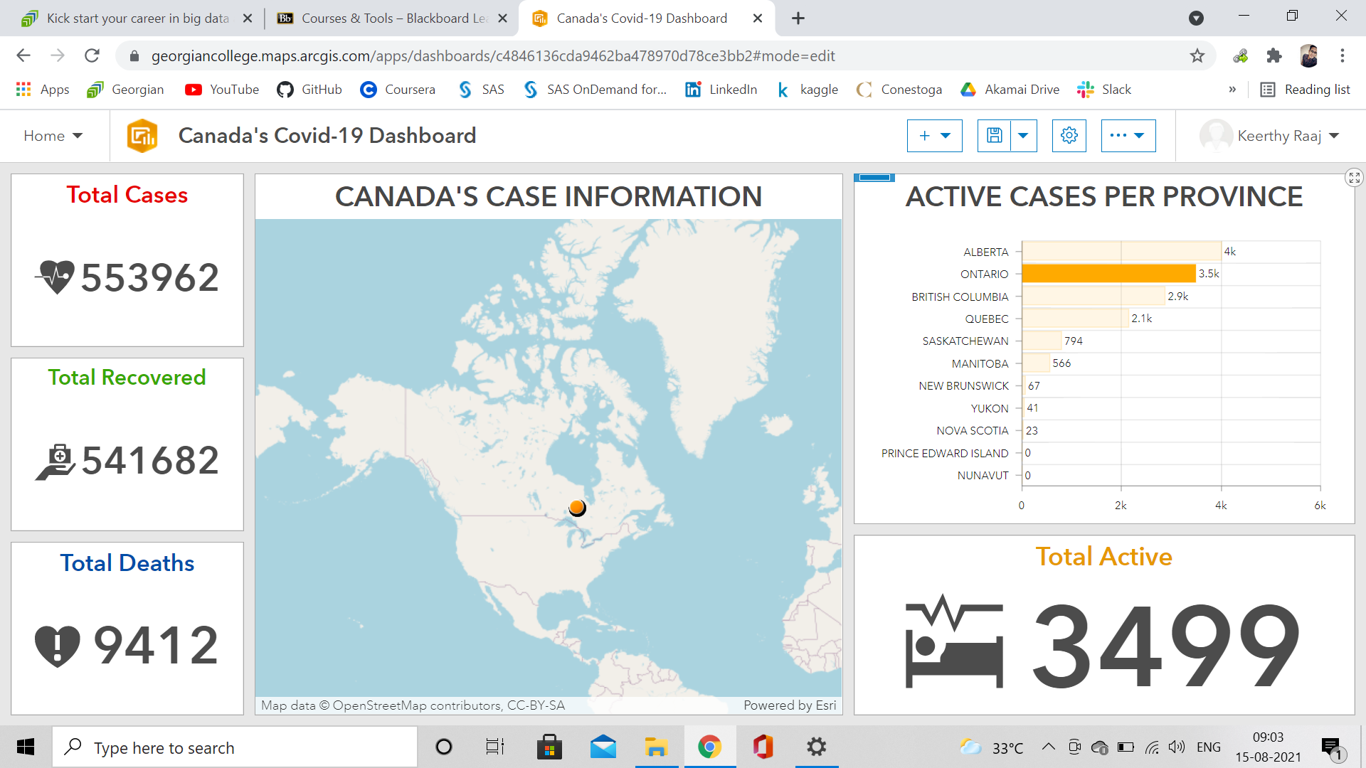

Slide 7
Insights
https://insights.arcgis.com/#/edit/bd06d0be1a4b4ee19a285ee5f0ef5873

Slide 8
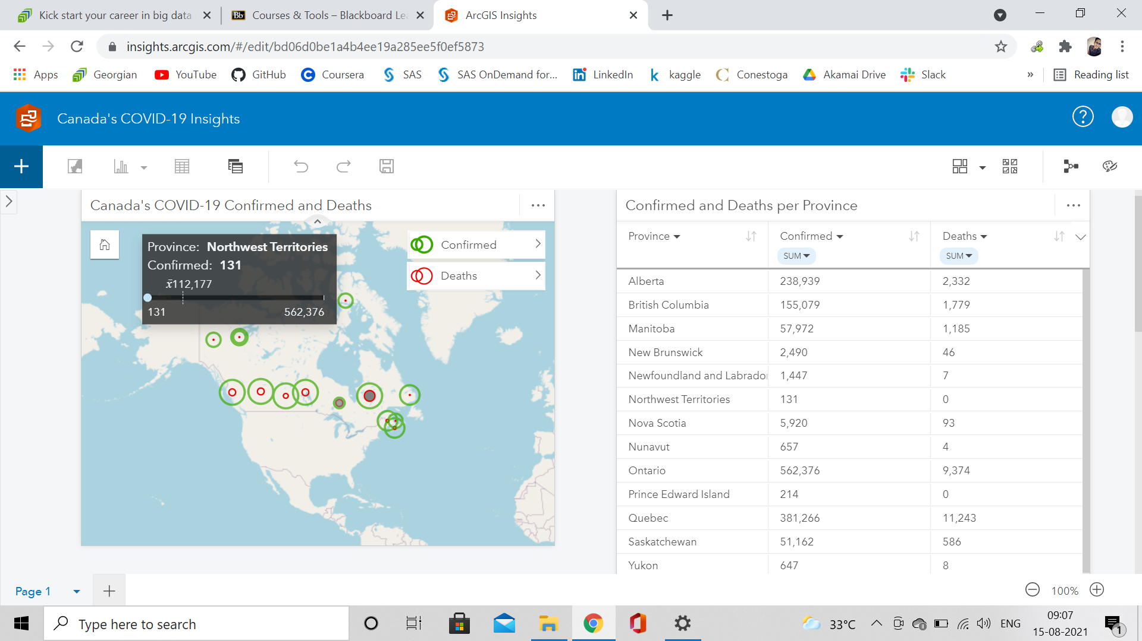

Slide 9
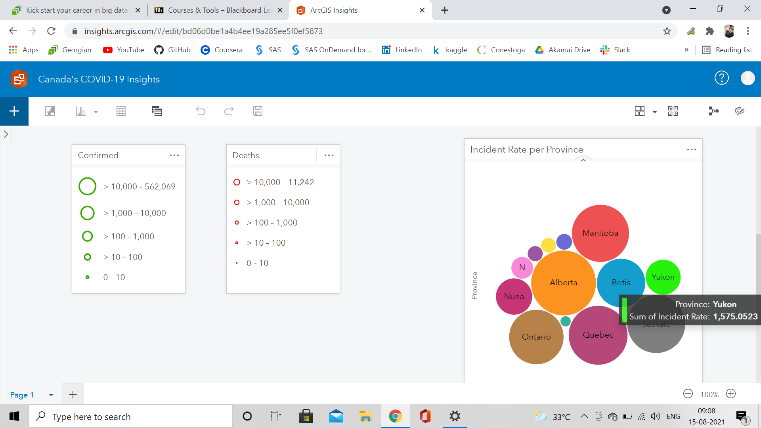

Slide 10
Story Map
https://storymaps.arcgis.com/stories/64946dab30b5459798acdebea9bf941f

Slide 11


Slide 12


Slide 13


Slide 14
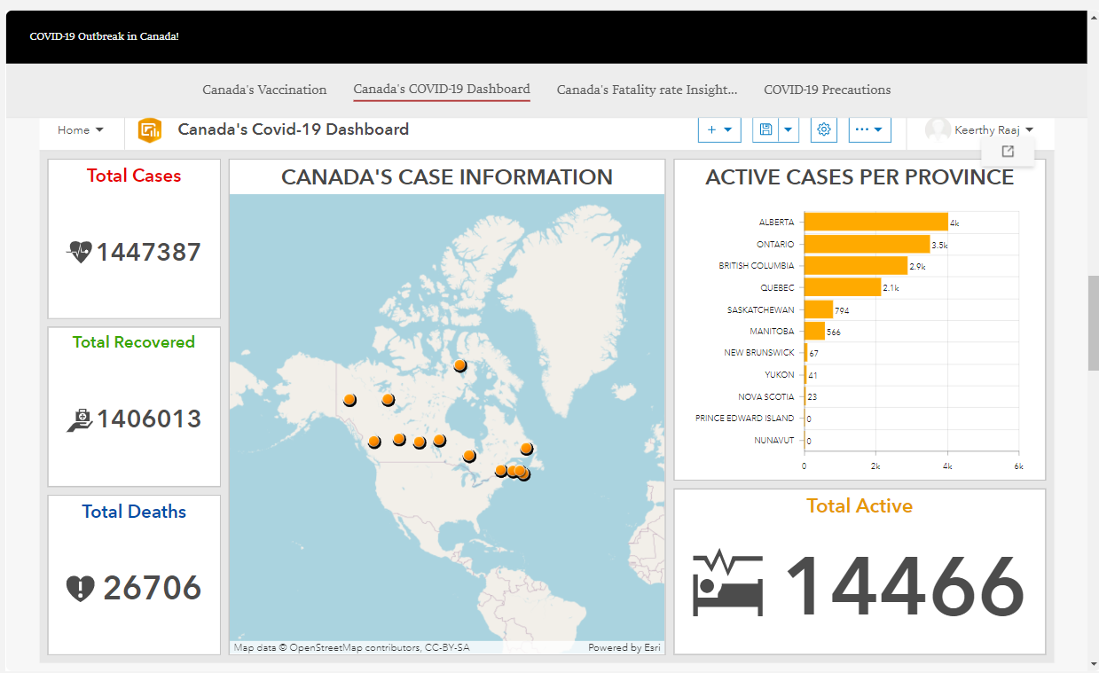

Slide 15
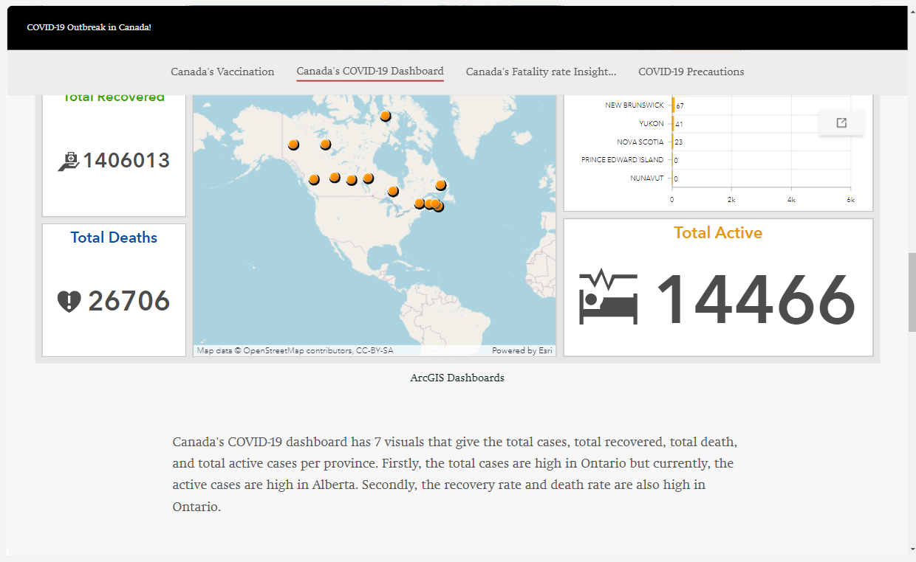

Slide 16
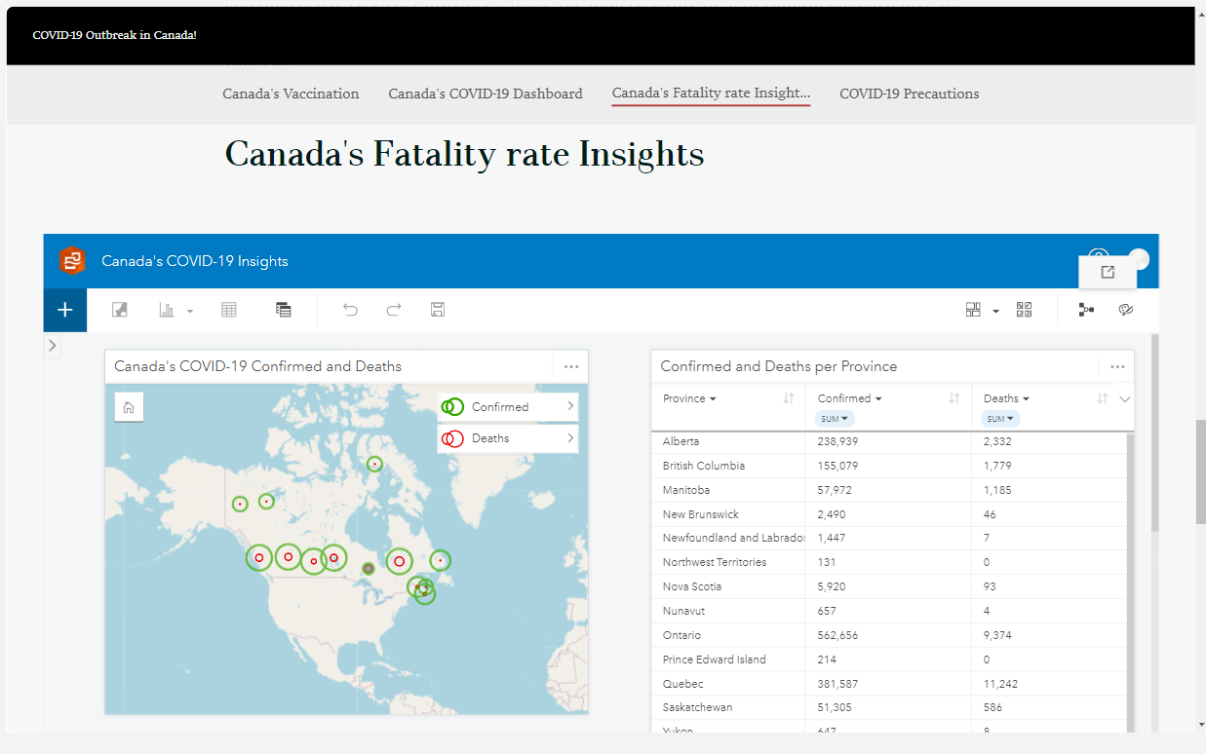

Slide 17
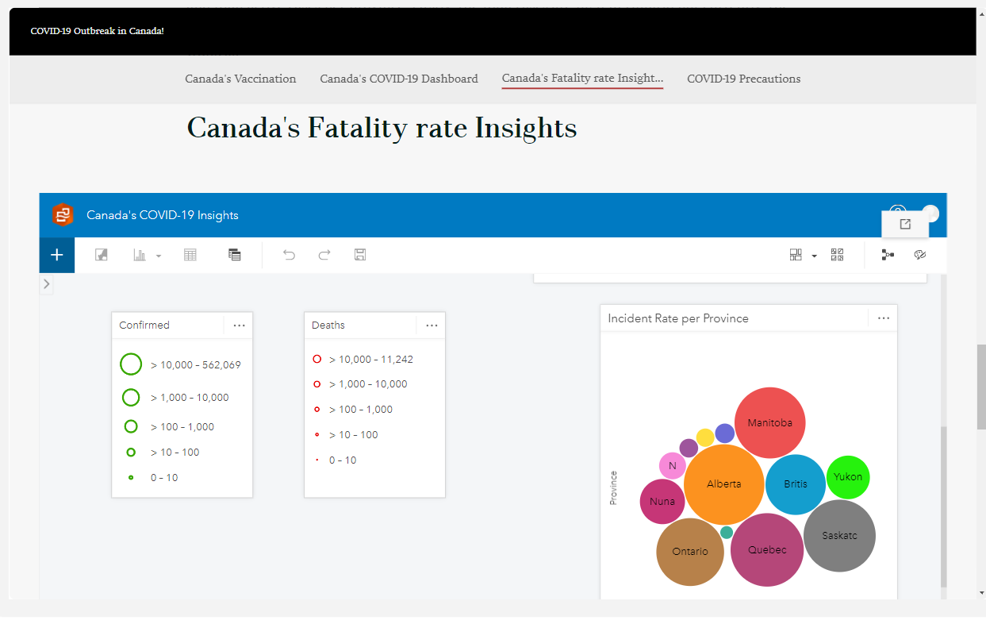

Slide 18
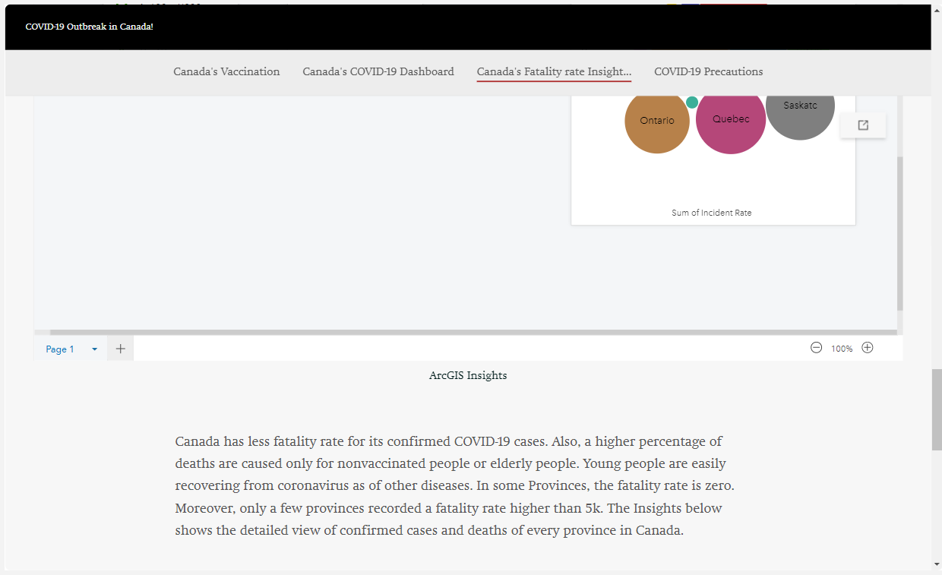

Slide 19
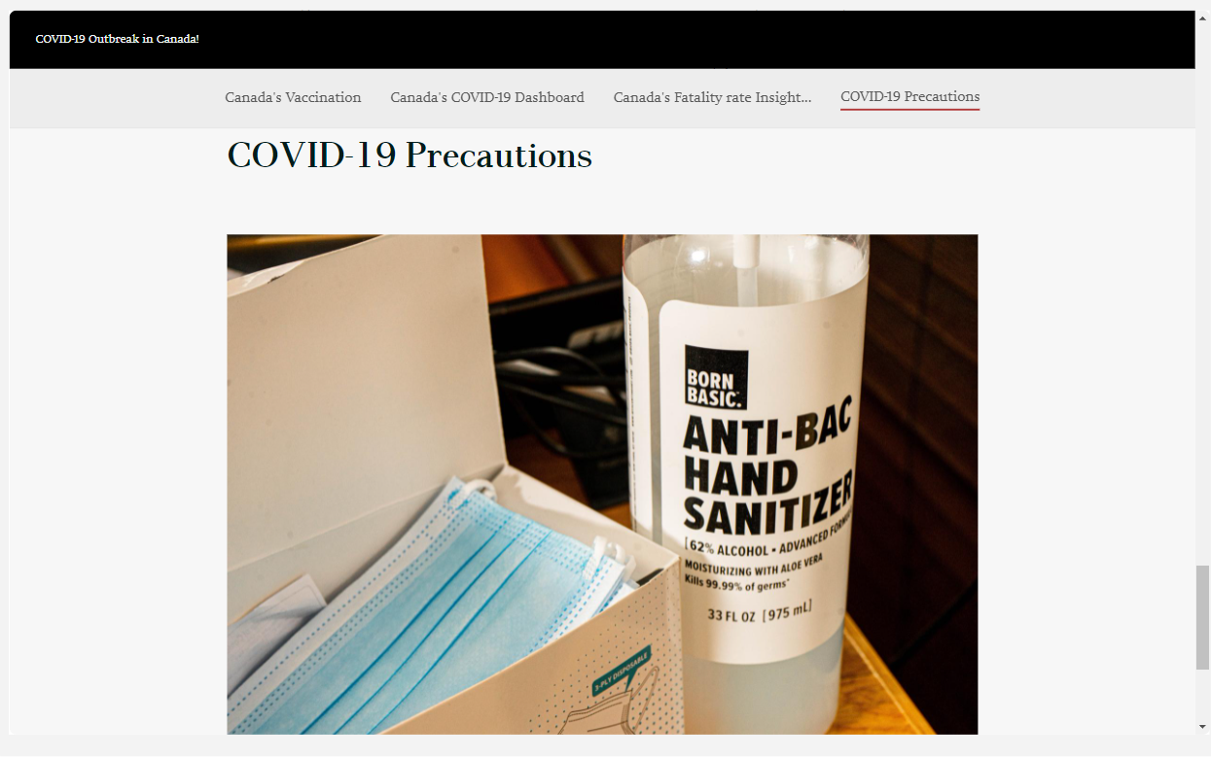

Slide 20
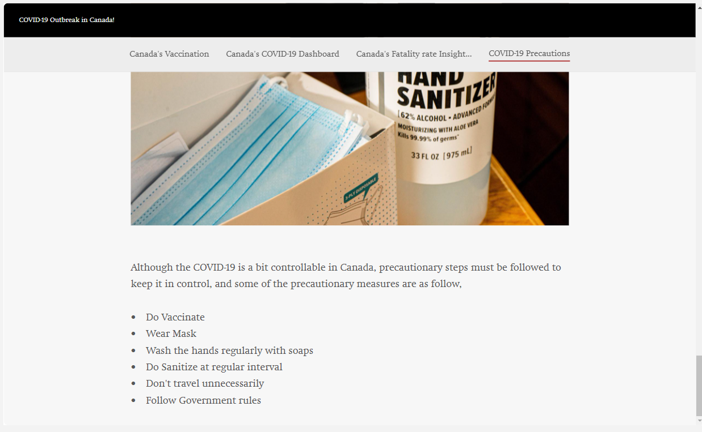

Slide 21
THANK YOU !

